Slide 1
CWRUded
JACOB ALSPAW

Slide 2
Who am I?
St. Louis, MO
5th Year in Computer Science w/ focus in Software Engineering
Graduate in less than a month
Plenty of experience with mobile and web development

Slide 3
Why am I here today?
I have a really cool service that I want to bring to campus!

Slide 4
What’s the problem?
Waiting Sucks
Nobody likes walking into an overly-crowded place, whether it’s a gym, library, or dining hall
CWRU has no good way to gauge how busy campus buildings are without going to one yourself
Many students have to deal with these inconveniences ex1: dinning hall has very limited seats ex2: KSL has very limited seats ex3: No room in the gym to workout
End up wasting time

Slide 5
Is there a solution?
Yes.

Slide 6
Inspiration
Waitz
UCSD
Direct quote from UCSD students: "Waitz has a huge presence on campus" (2018)
What is the Waitz team up to now?

Slide 7
Introducing CWRUded
Pronounced “crowded”
A service that allows its users to see how busy areas are in real-time, saving them time and frustration
Enables users to “know before they go”
CWRUded will report the real-time "busyness" for locations around campus
It does this by estimating how many people are in a general location at any point in time

Slide 8
How can campus benefit?
Improve upon student-life greatly by allowing students to plan ahead of time
Eliminate the inconvenience of arriving to a campus building only to find that it’s full
Will save students time and frustration

Slide 9
Where would we put this service?
Think anywhere that CWRU WiFi is available...
Carlton Commons
Fribley
Nord
Sears
A.M. Medical Library
Kelvin Smith Library
Tink
Thwing
Wade
Starbucks on E115
Veale
Wyant
Think[Box]

Slide 10
How does CWRUded work?
Estimates how many people are in a general location using an automated polling process already supported by the underlying Cisco Prime Network Infrastructure that Case Wireless uses
Polling process aggregates a set of distinct and “relevant” devices connected to a wireless router in a general location
“Relevant”: If a device has not been active recently, then the device has disconnected from the network, and its user is no longer considered to be in the area
From these results, we can derive an estimate for how busy a certain location is in real time

Slide 11
How does CWRUded work?
Polling process data
How many devices are connected to wireless access point
Who is connected to wireless access point
Conversion from devices to people:
~ 1.5 devices / CWRU student
Comparing the number of devices to an expected maximum for the location will give us a relative “busyness” rating as a percentage of maximum capacity

Slide 12
How does CWRUded work?
U[Tech] can provide all of the required data (with approval)
No crowdsourcing required by students, faculty, or staff!
Highly maintainable because the process can be automated

Slide 13
Aggregating Results Further Explained
How accurate are results?
Measuring the number of users on a wireless network is can be unreliable
Getting an exact number of users is nearly impossible
Requires network users to be actively sending data
But we don’t care about exact numbers!
Estimates are good enough to measure how busy a location is
We just need to compare the estimated number of devices to a predetermined expected number of devices. If the estimate is higher than the expected, then we know that a location is busy

Slide 14
Data Privacy
U[Tech] network administrators will handle sensitive requirements
CWRUded will not track the movements of people around campus
Polling process never associates an individual with a location
Data only exposes a NUMBER of connected devices
Safe, Secure, Trusted, and Reliable

Slide 15
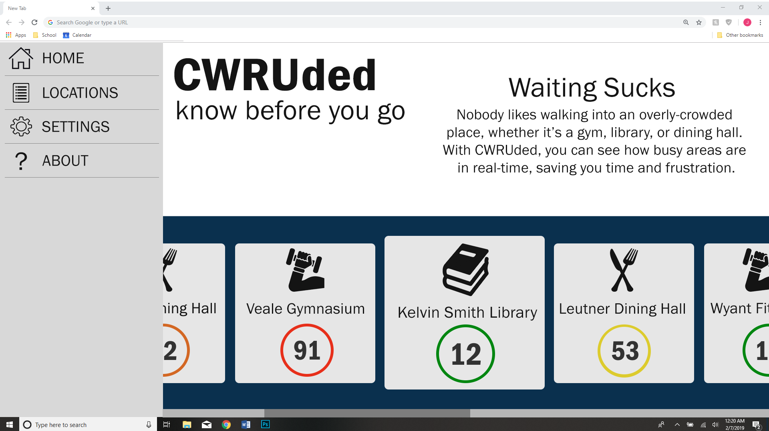

Slide 16
The application
Let’s try it out.

Slide 17
What’s next?
I have the basics
Need to start testing on the campus network
Make changes that will give the best possible solution
Then deploy services to campus (website, IOS, Android)
Improve more with user feedback
Testing
Refinement
Deployment
Refinement

Slide 18
How do we setup for campus use?
The application and server are nearly finished
Automated polling process needs to be setup
Will likely be difficult and take time
The last thing is to retrieve data from U[Tech]
Injecting the data into the application is trivial

Slide 19
Maintaining the Application
I graduate in May, but I’m staying in Cleveland
I want continued ownership of CWRUded
Software development is my hobby
I’ve wanted to leave my mark on CWRU since I was accepted over 5 years ago
Optionally, there are MANY options for students to continue supporting the CWRUded service

Slide 20
What if CWRUded is a success?
Improve upon student-life greatly by allowing students to plan ahead of time
Eliminate the inconvenience of arriving to a campus building only to find that it’s full
Will save students time and frustration

Slide 21
What if CWRUded is a failure?
2 options
Take it offline
Leave it up
Tear down would be simple

Slide 22
Regardless...
This is a stepping stone for other ideas that I’d like to bring to campus

Slide 23
What do I need?
Permission to proceed using the campus network data
Time to connect the data to the service
Small operating budget
Application design budget
Supplies budget

Slide 24
Questions?

